Slide 1



Slide 2

HTML Forms
Basic purpose :
Is to allow the user to enter data on one end and then send the data on the other end through web server
HTML form has 3 important parts
1) <form>:
Which includes URL of the script needed to process the form
2) Form elements:
Which are similar to the text fields buttons, checkboxes, text fields, radio buttons, drop-down menus, etc.
3) Submit button:
  Which send the data on the web server.

Slide 3
The <form> tag
The <form arguments> ... </form> tag encloses form elements (and probably other HTML as well)
The arguments to form tell what to do with the user input
  action="url" (required)
    Specifies where to send the data when the Submit button is clicked
  method="get" (default)
    Indicates that the form data has to be encoded by the web browser into a URL.
    Can be used only if data is all ASCII and not more than 100 characters
  method="post"
    Form data is sent in the body of the URL request

Slide 4
The <form> tag
target="target"
    Tells where to open the page sent as a result of the request
    target= _blank means open in a new window
    target= _top means use the same window

Slide 5
The <input> tag
  To provide input to a form <input> tag is used.
Input tag attributes include:
1) type : type of input element
text, checkbox, radio, password,hidden, submit, reset, button, file, or image
  2) name:
  The name attribute is used to reference elements in a JavaScript

Slide 6
The <input> tag contd..
3) value:
Defines the text to be written on the selected form element.
4) read only:
  The value cannot be changed. It can be used only with type=“text”
  5) disabled:
  Disables the input element when it loads on the web server.
  User cannot write or select it again.

Slide 7
Ex of form—Adding button
<html>
    <head>
    <title>adding button</title>
</head>
<body>
<form action="">
<input type="button" value="Hello World">
</form>
</body>
</html>

Slide 8
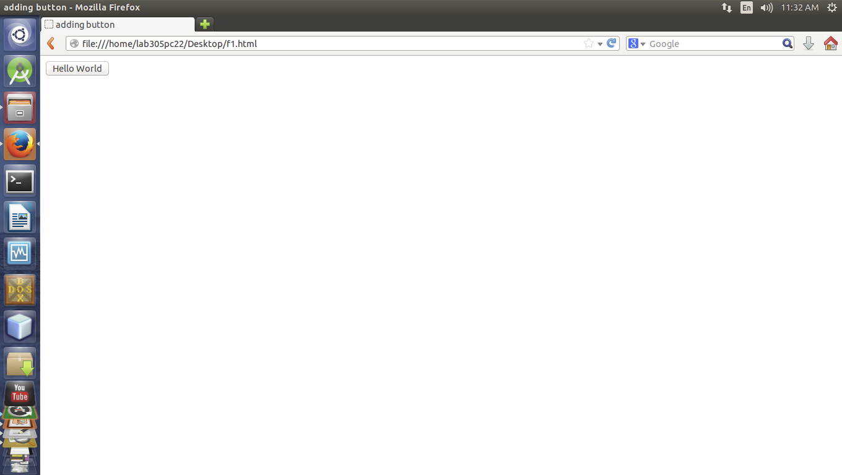

Slide 9
Ex of form—Adding textfield
<html>
<head>
<title>adding textfield </title>
</head>
<body>
<form action="">
First name:
<input type="text" name="firstname" size="30">
<br>
Last name:
<input type="text" name="lastname" size="30">
</form>
</body>
</html>

Slide 10


Slide 11
Ex of form—Adding textfield with submit button
All the data in the form sent to the web server when you click the SUBMIT button
<html>
<head>
<title>adding textfield</title>
</head>
<body>
<form action="text.html" action=”get”>
First name:
<input type="text" name="firstname" size="30">
<br>
Last name:
<input type="text" name="lastname" size="30">
<br>
<input type="submit"value="SUBMIT">
</form>
</body>
</html>

Slide 12


Slide 13
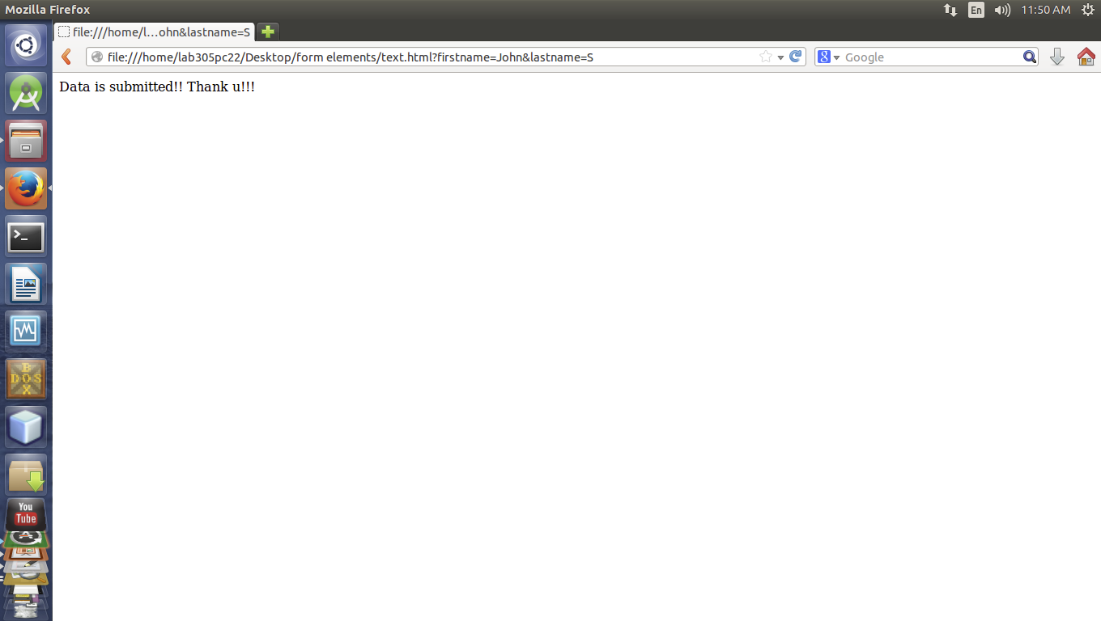

Slide 14
Attributes of Submit button
Attributes | Description
name | Adds an internal name to the button so the program that handles the form doesn't confuse the button with the other fields.
value | Defines what is written on the button.
align(unsupported in HTML5) | Defines how the button is aligned. Valid entries are: TOP, MIDDLE, BOTTOM, RIGHT, LEFT, TEXTTOP, BASELINE, ABSMIDDLE, ABSBOTTOM.
tabindex | Defines in which order the different fields should be activated when the visitor clicks the tab key.

Slide 15
Reset Button
A reset button helps the user to clear all the data that have been entered in text fields and start all over again.
Ex:
<input type="reset" name="RESET" value=”RESET">

Slide 16
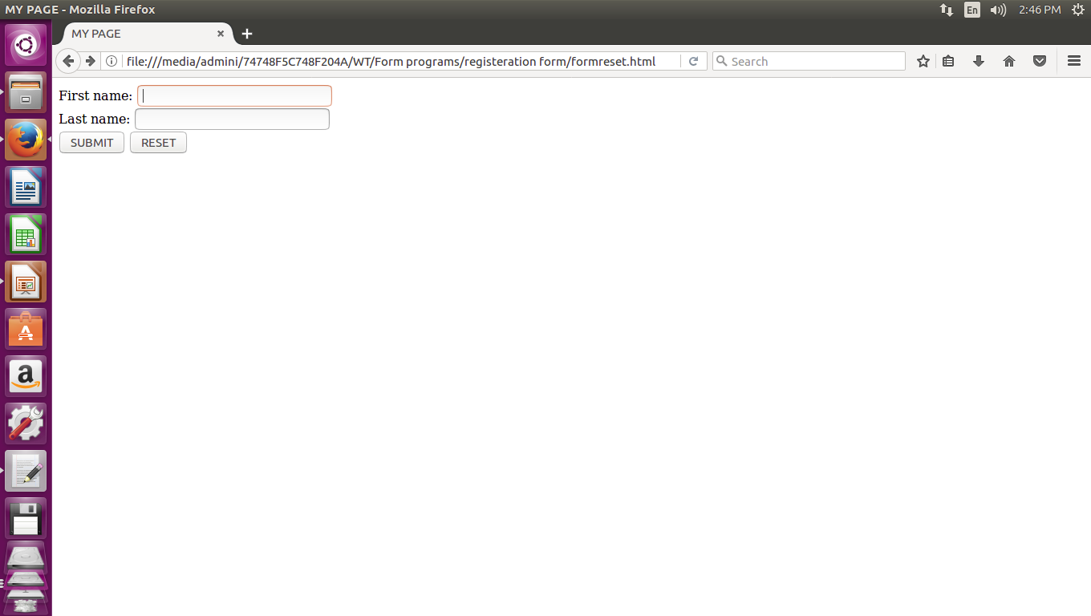

Slide 17


Text input
A text field:
<input type="text" name="textfield" value="with an initial value">
A multi-line text field
<textarea name="textarea" cols="24“ rows=2>Hello </textarea>

Slide 18

Text input contd..
A password field:
<input type="password" name="textfield3” value="secret">

Slide 19
Checkboxes
A checkbox:
<input type="checkbox" name="checkbox”
value="checkbox" checked>
type: "checkbox"
name: used to reference this form element from JavaScript
value: value to be returned when element is checked.
The checked attribute is a boolean attribute.
When present, it specifies that an <input> element should be pre-selected (checked) when the page loads.

Slide 20

Checkboxes
Ex:
Checkbox: <input type="checkbox" name="myCheck" value="myvalue">
Value will get returned after selecting checkbox:
myvalue

Slide 21
Radio buttons
A radio button is displayed as a click and displays a dot in the middle when selected.
Ex:
YES:
<input type="radio" name="poll" value="yes">
<br>
No:
<input type="radio" name="poll" value="no">

Slide 22
Radio buttons
Ex:
<input type="radio" name="agree"
checked value="a">I agree completely<br>
<input type="radio" name="agree"
value="b">I agree a little<br>
<input type="radio" name="agree"
value="c">I disagree a little<br>
<input type="radio" name="agree"
value="d">I disagree completely<br>

Slide 23

Drop-down menu or list
A menu or list:
<select>
<option value="red">red</option>
<option value="green">green</option>
<option value="BLUE">blue</option>
</select>
Additional arguments:
  size: the number of items visible in the list (default is "1")
  multiple: if set to "true", any number of items may be selected (default is "false")

Slide 24
Iframe tag
Inline frames, commonly just referred to as "iframes", are the only type of frame allowed in HTML5.
These frames are essentially a section of your page that you "cut out

Slide 25
Iframe tag
How to Use the IFRAME Element
The element uses the HTML5 global elements :
—the URL for the source of the frame
—the height of the window
—the width of the window
—the name of the window
Ex:
<iframe src="Sunset.html” width="200px" height="200px" align=”right”>
Alternate text if the iframe cannot be rendered
</iframe>

Slide 26
